Slide 1

USED CAR PRICE Problem

Slide 2
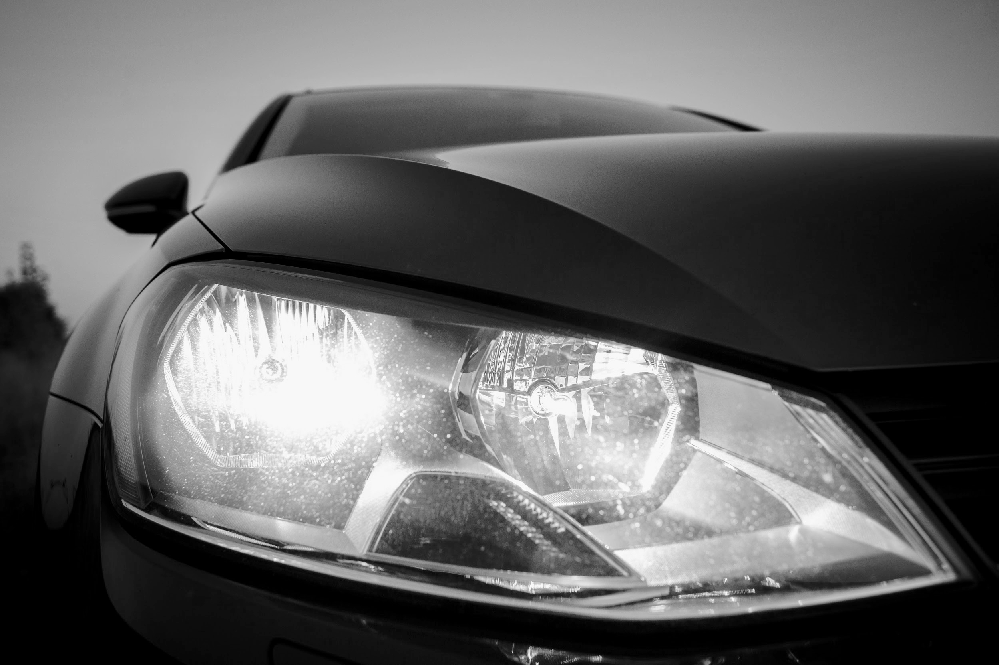
Used Car
PROBLEM & SOLUTION

Slide 3
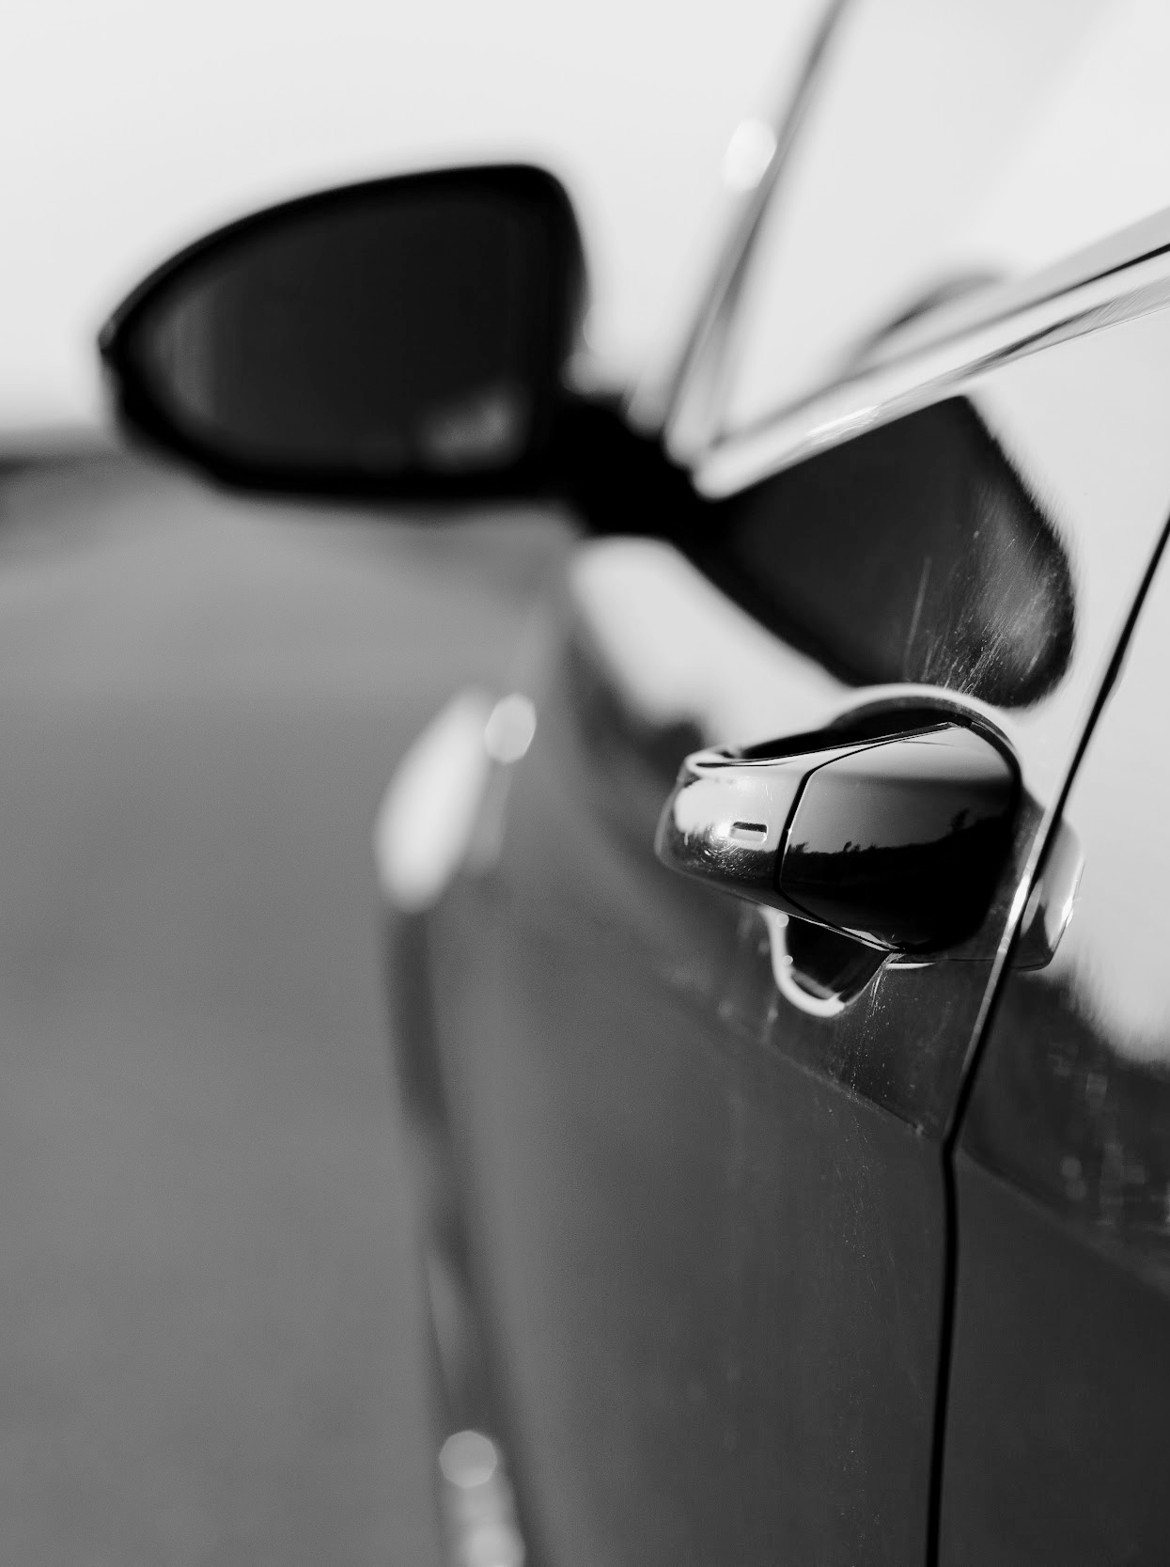
INTRODUCTION
The goal of this project was to use linear regression models to know if customers would be willing to pay for a used vehicle based up the vehicle's characteristics? To Recommendations for Business

Slide 4
PROBLEM
SOLUTION
What customers would be willing to pay for a used vehicle based up the vehicle's characteristics?
Through the data science will achieve and solve this problem in the business filed

Slide 5
Overview
Data Cleaning & Preprocessing
DataSet
Conclusion
EDA Exploratory Data Analysis
1
2
3
4
5
modeling

Slide 6
Tools
Data manipulation
Visualization
Modeling
Numpy and Pandas
Matplotlib and Seaborn
Scikit-learn

Slide 7
Dataset
8,128
13
Name : Name of car
Year : Production year
Selling price : Price of car
Km Driven : Km Driven of car
ROWS
Fuel : Type of fuel like Diesel ets.
Seller Type : Individual, Dealer
Transmission : Manuel, Automatic
COLUMNS
Owner : First or Second owner ets.
Mileage : Kilometers Per Liter
Engine : CC capacity of combustion cylinder
Max power : horsepower of the car
Torque : Newton meters
Click to see Dataset
Seats : Number of seat

Slide 8
Data Cleaning & Preprocessing
1
2
Create new column (Car)
3
Delete shortcut
4
Transform a data type
Removing 221 of rows having null value the dataset having about 7,906 rows
Remove null value
Deleting name of the car and replace with new column which is represent company of car
Delete (Kpml) from Mileage
Delete (CC) from Engine
Delete (bhp) from Max power
Transform data type from object to float
Delete Torque column because torque is not add value for both customer and business
5
Delete column not used in data analysis

Slide 9
Dataset Cleaning & Preprocessing
BEFORE
name | year | Selling price | Km driven | fuel | Seller type | transmission | owner | mileage | engine | Max power | torque | seats
Maruti Swift Dzire VDI | 2014 | 450000 | 145500 | Diesel | Individual | Manual | First Owner | 23.4 kmpl | 1248 CC | 74 bhp | 190Nm@2000rpm | 5.0
AFTER
year | Km driven | fuel | Seller type | transmission | owner | mileage | engine | Max power | seats | cars | Selling price
2014 | 145500 | Diesel | Individual | Manual | First Owner | 23.40 | 1248.0 | 74.00 | 5.0 | Maruti | 450000

Slide 10
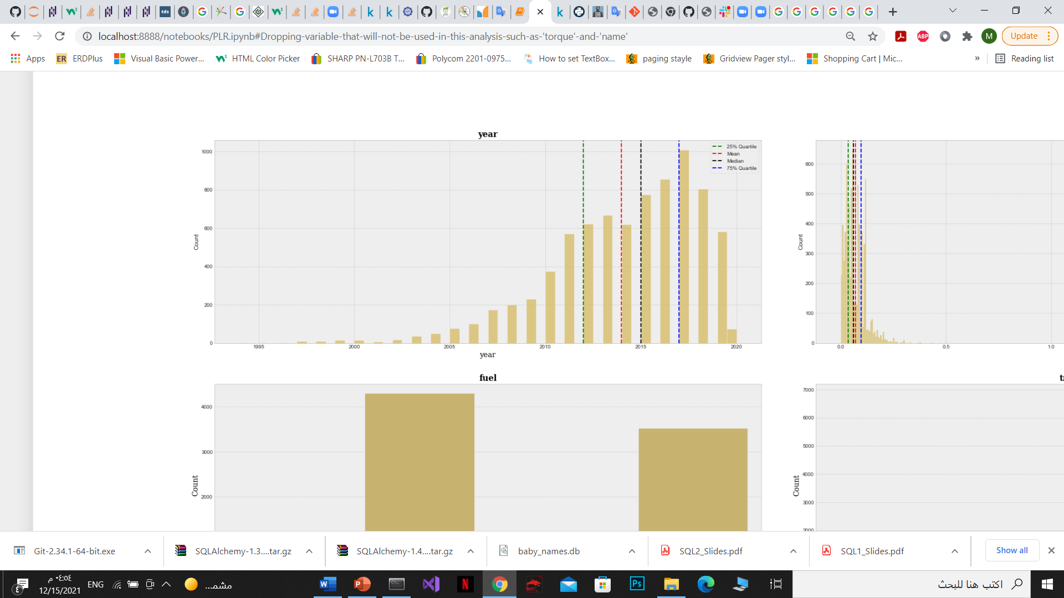
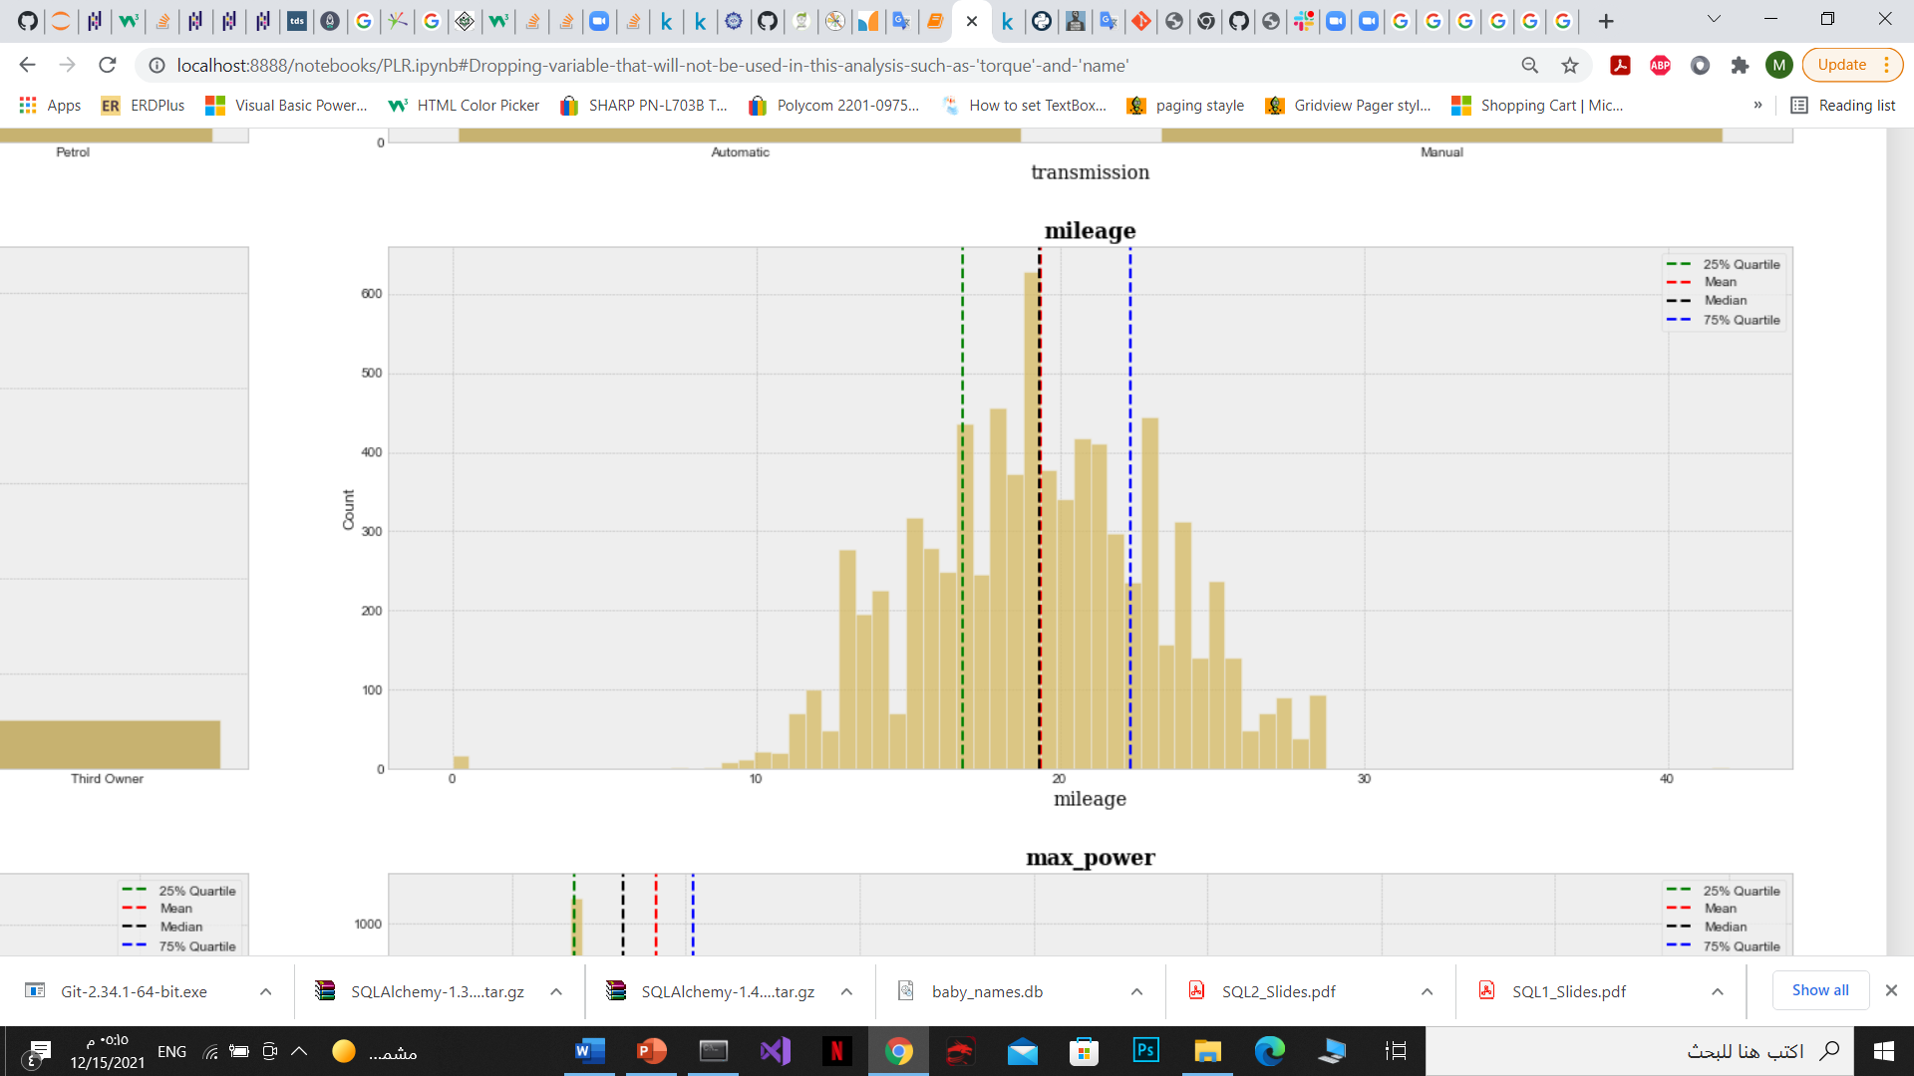
EDA

Slide 11
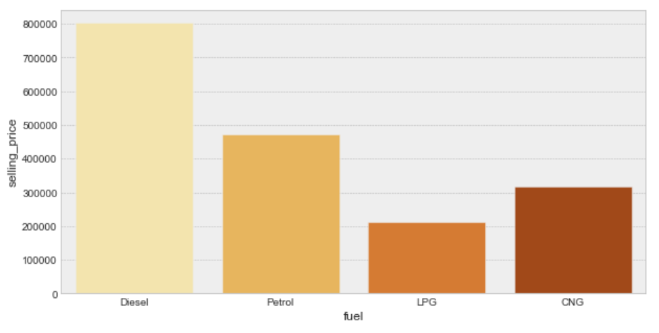
EDA

Slide 12
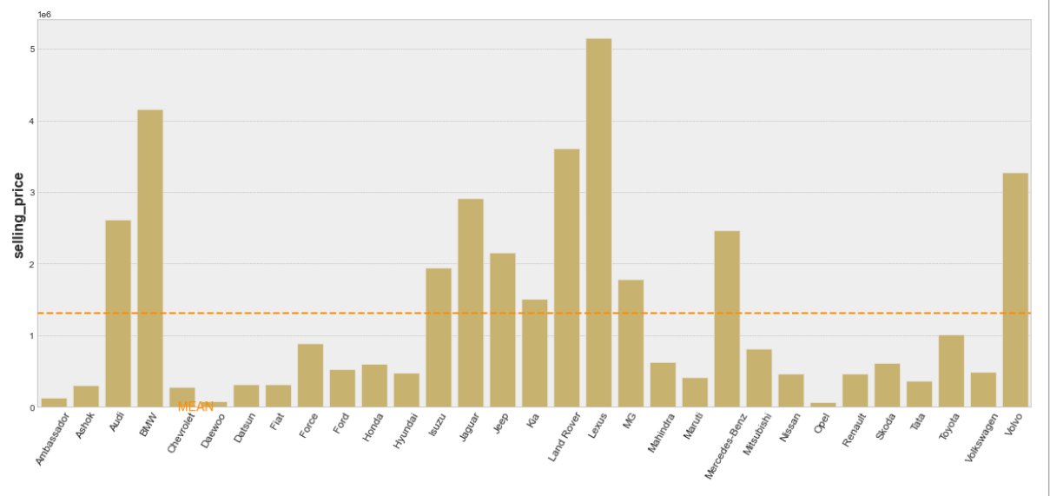
EDA

Slide 13
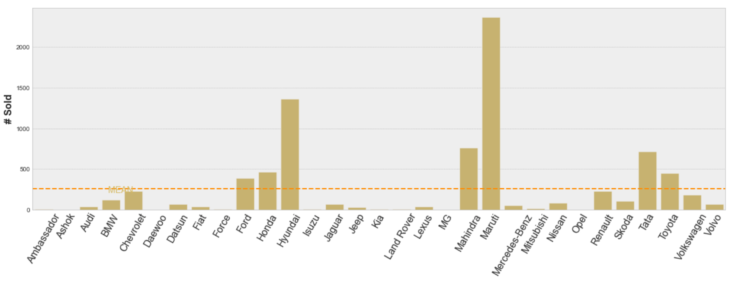
EDA

Slide 14
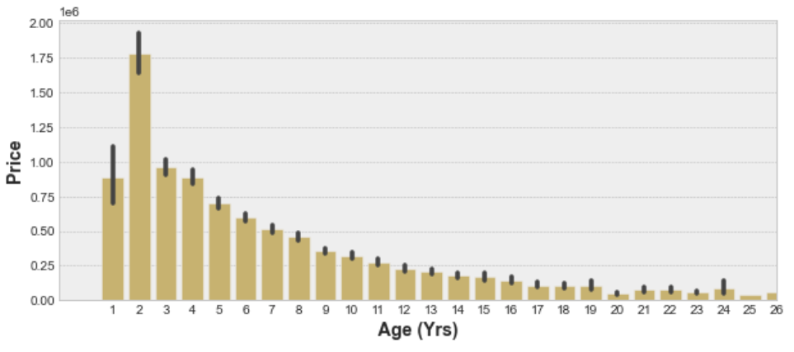
EDA
Age = year - 2021

Slide 15
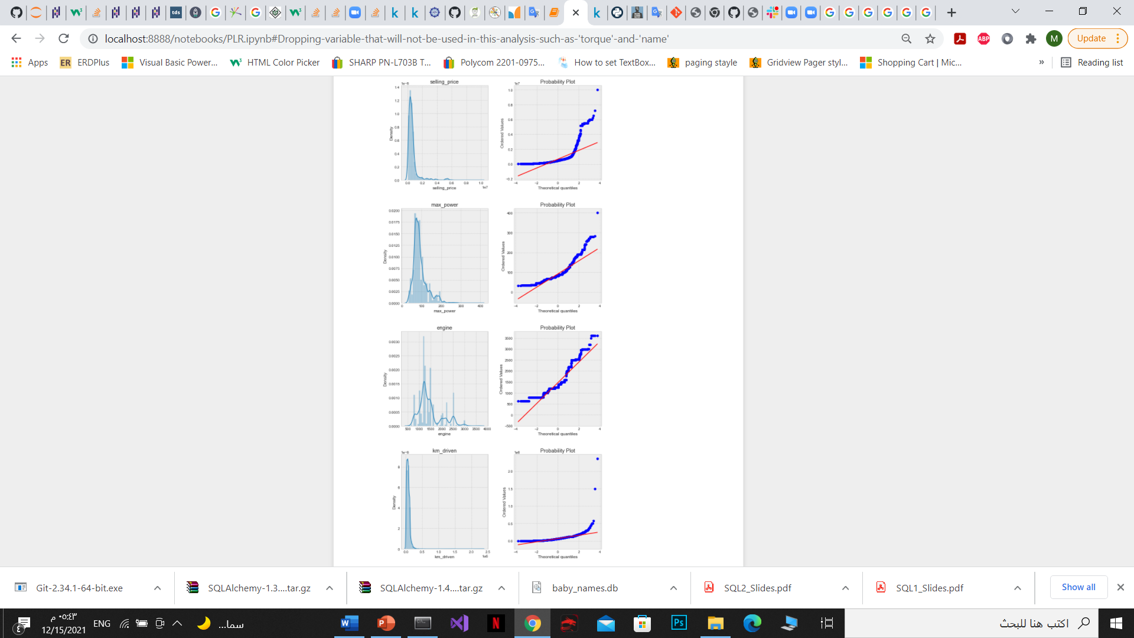

EDA
after did ['log'] these are good for the purposes of the linearity assumption

Slide 16
MODELING
70%
30%
Building the model with Linear Regression Model with scores accuracy 92%
•R-squared = 0.923
•Mean absolute error = 0.17
Train size
Test size

Slide 17
CONCLUSION
Conclusion and Recommendations for Business
Analysis of trends in used car vehicle sales indicates that:
Maruti, Hyundai, Honda, Toyota, Ford, Mahindra and Tata are sold in higher volume than other vehicle makes, and the preferred makes are lower in price.
The Price (lower rather than higher) is a significantly factor in customer purchasing decisions.
The customers overwhelmingly prefer manual transmissions over automatic.
The customers tend to purchase used vehicles 2 -5 years old.
The customers prefer vehicles with mileage between 15-25 kmpl.
Based upon the above observations, it is recommended that focuses its inventory to match such preferences. Since the higher in demand makes are lower in price than other makes, focusing on stocking these makes will result in less flooring, reducing capital investments.
The model that has been provided in this analysis is a 92% accurate pricing model for determining what customers would be willing to pay for a used vehicle based up the vehicle's characteristics. It has been shown that the model is reliable, meeting the assumptions for linear regression and demonstrating a low error rate.

Slide 18
Thanks

